Slide 1
Simulation Modelling with Python
Dr Geraint Palmer
Cardiff University

Slide 2
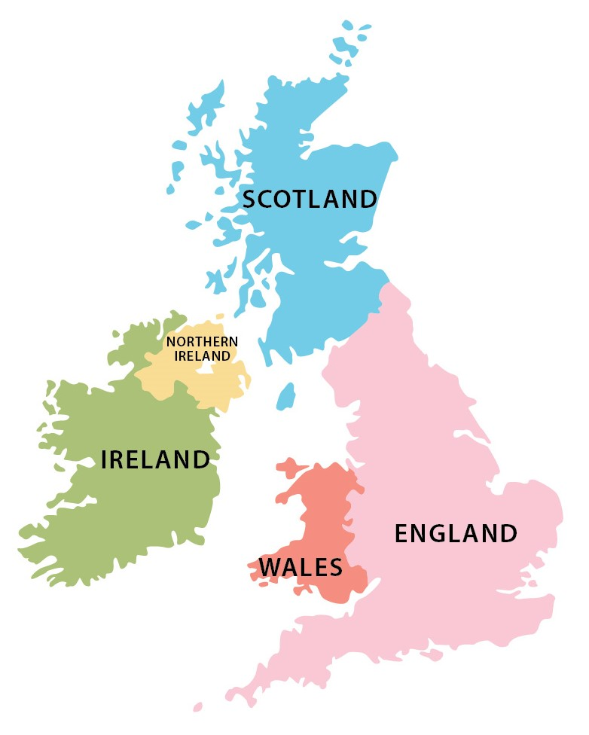

Who are we?

Slide 3
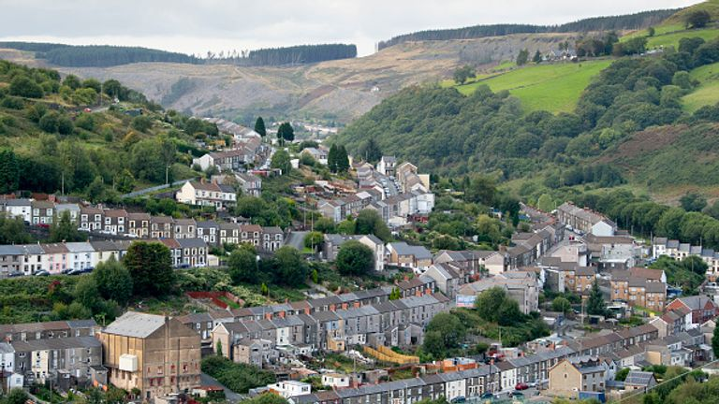

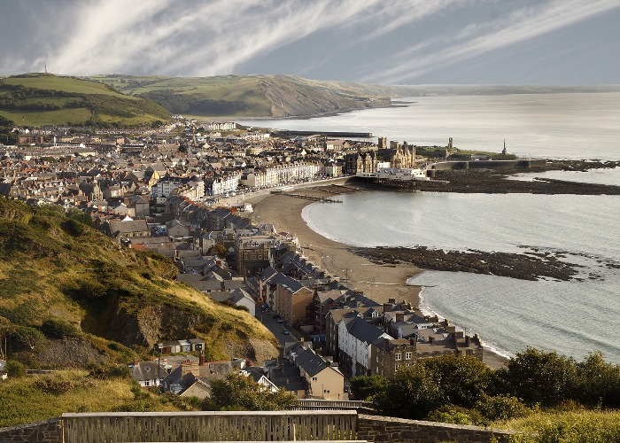

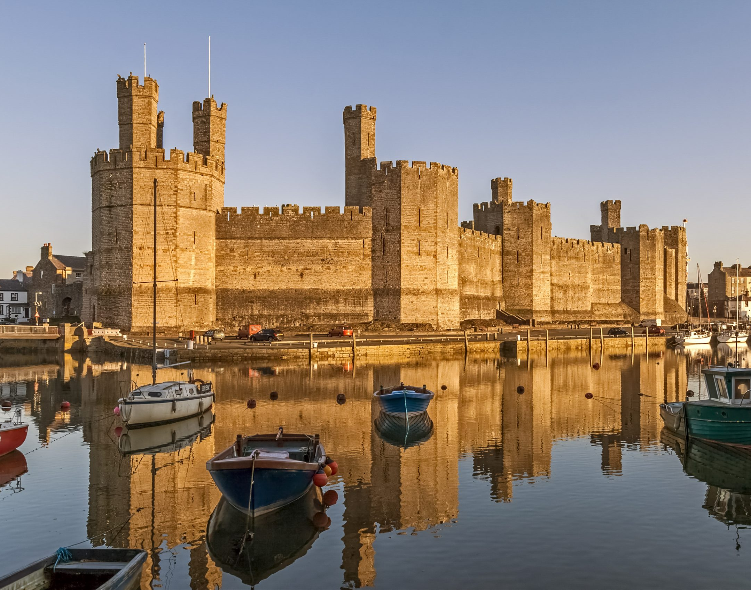
Mae hen wlad fy nhadau yn annwyl i mi Gwlad beirdd a chantorion, enwogion o fri Ei gwrol ryfelwyr, gwladgarwyr tra mâd Tros ryddid gollasant eu gwaed Gwlad! Gwlad! Pleidiol wyf i'm gwlad Tra môr yn fur i'r bur hoff bau O bydded i'r hen iaith barhau.

Slide 4
Who am I?
2018 PhD:
Modelling older people’s use of health facilities
2022 Ambulance Modelling:
Working with 118 in Jakarta
2015 Started developing Ciw:
A simulation library for Python
2019 Lectureship:
Cardiff University
Present Supervising PhDs:
Simulating orthopedics
Scheduling telehealth appointments
Understanding alcohol behaviors
Modelling vaccine rollout

Slide 5
Optimising Ambulance Allocations in Jakarta

Slide 6
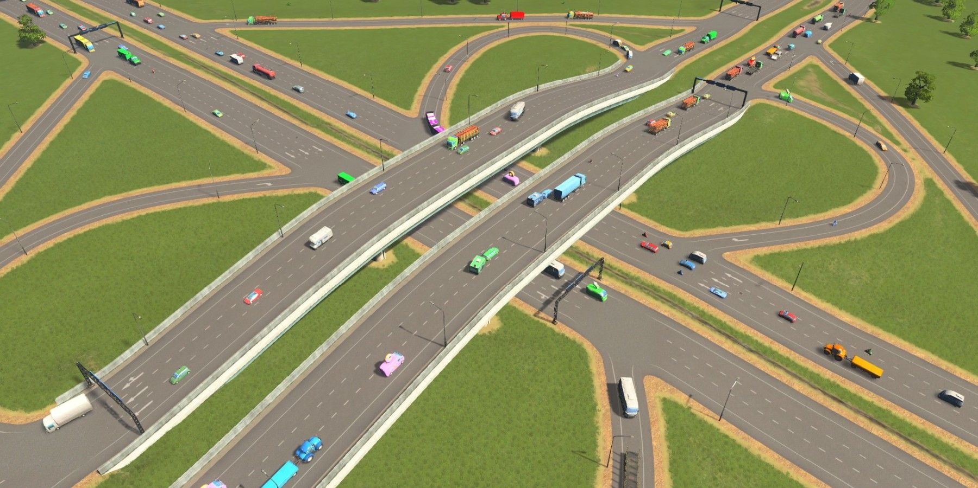
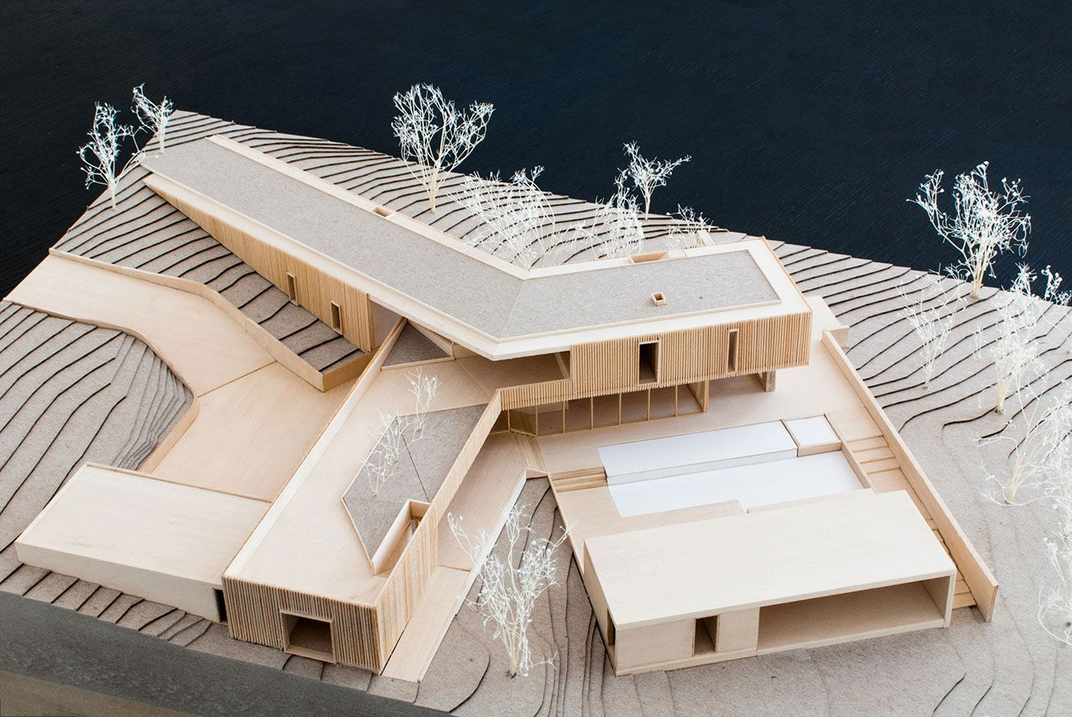
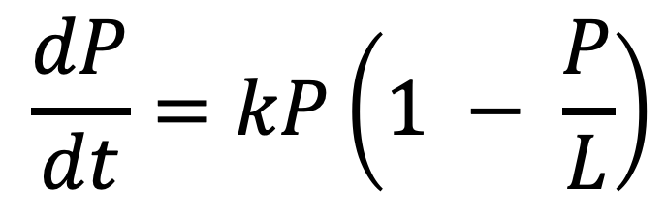
What is a model?
$$\frac{dP}{dt}=kP\left(1 − \frac{P}{L}\right)$$

Slide 7

Open source
Free
Transparent
Reproducible
Sustainable
Integrated & Modular
Why Python?
Pre- and post- data processing
Simulation
Optimisation
Methodology

Slide 8
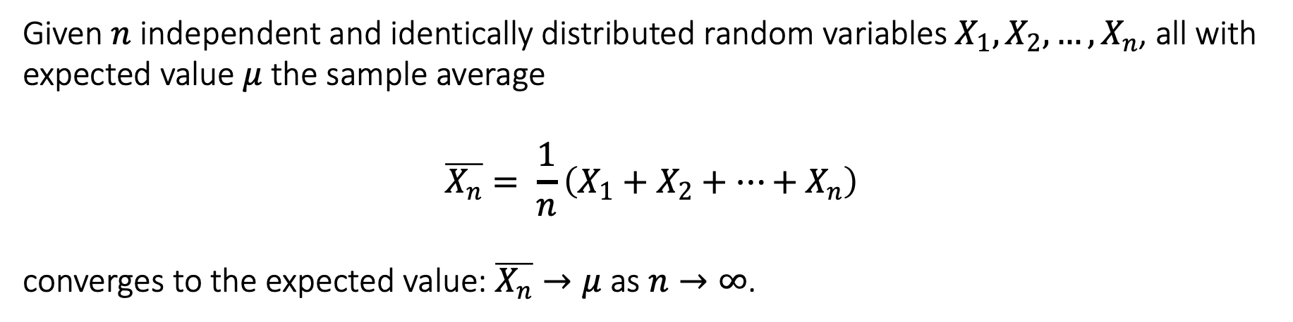
Law of Large Numbers
Given $n$ independent and identically distributed random variables $X_{1}, X_{2}, …, X_{n}$, all with expected value $μ$ the sample average
$$\overline{X_{n}}= \frac{1}{n}\left(X_{1}+X_{2}+…+X_{n}\right)$$
converges to the expected value: $\overline{X_{n}}→μ$ as $n→∞$.

Slide 9
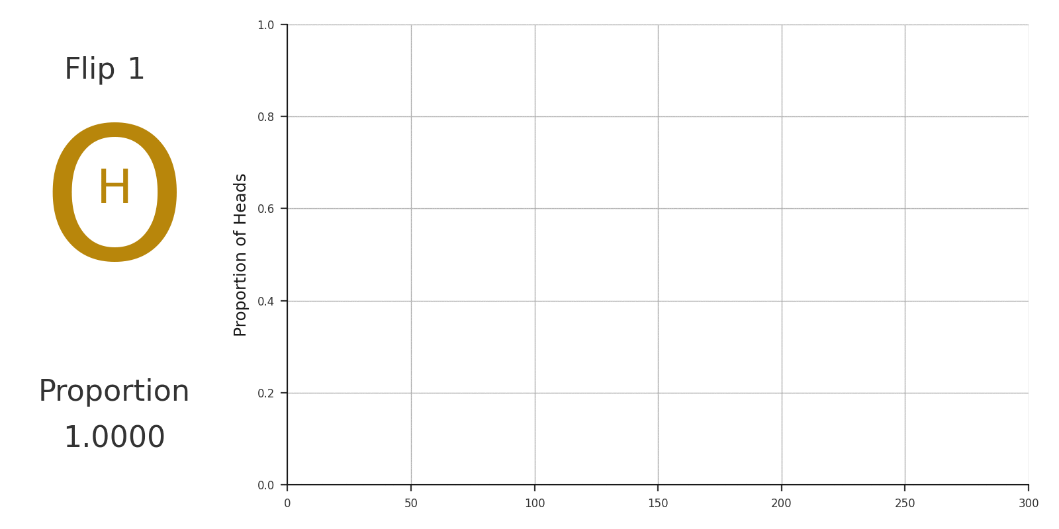
Law of Large Numbers

Slide 10
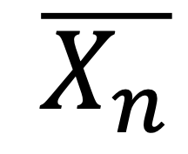
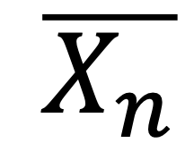


Monte Carlo Simulation
If we know
then we know about
$$μ$$
$$\overline{X_{n}}$$
Law of Large Numbers
then we can estimate
If we generate
$$μ$$
$$\overline{X_{n}}$$
Monte Carlo Simulation

Slide 11
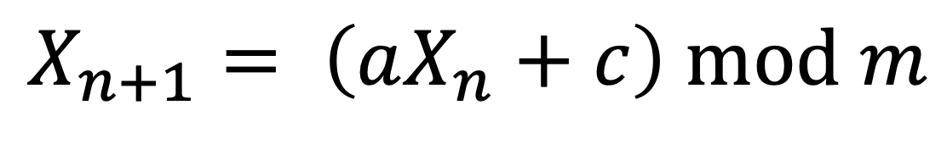
(3 * X) + 7) % 53
Pseudorandom Numbers
Linear Congruential Generator
$$X_{n+1}= \left(aX_{n}+c\right) \text{mod} m$$
n | X_{n}
0 | 44
1 | 33
2 | 0
3 | 7
4 | 28
5 | 38
a = 3
c = 7
m = 53
Mersenne Twister

Slide 12
The random Library
>>> random.random()
>>> random.choice([‘A’, ‘B’, ‘C’])
>>> random.shuffle(my_list)
>>> random.seed(1)
>>> random.sample(my_list, 3)
>>> random.normalvariate(100, 20)

Slide 13
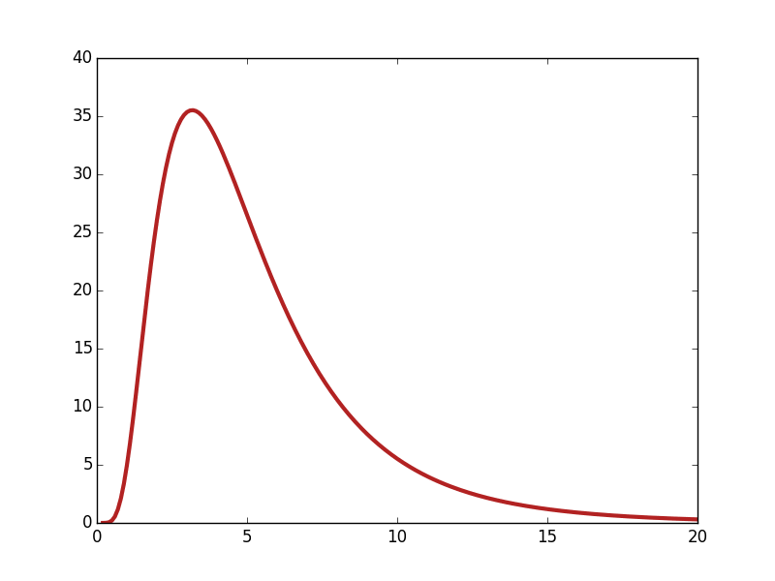

Slide 14
Example A: Falling Fridge Magnets
You have a fridge with fridge magnets on that spell the words HELLO WORLD. An earthquake strikes and two letters fall off the fridge at random. What is the probability that one of those letters is a vowel?

Slide 15
Task 1: Weight of a Shopping Bag
When grocery shopping, I buy apples with probability 0.8 and melons with probability 0.2. I roll a die to see how many of each fruit I buy. The weight of an apple is Uniformly distributed between 70 and 100 grams. The weight of a melon is Normally distributed with mean 1200g and standard deviation 250g.
What is the expected weight of the shopping bag?
Explore the effect of the number of repetitions on the expected weight.
What is the probability of the bag exceeding 6kg?
What does its weight distribution of the bag look like?

Slide 16
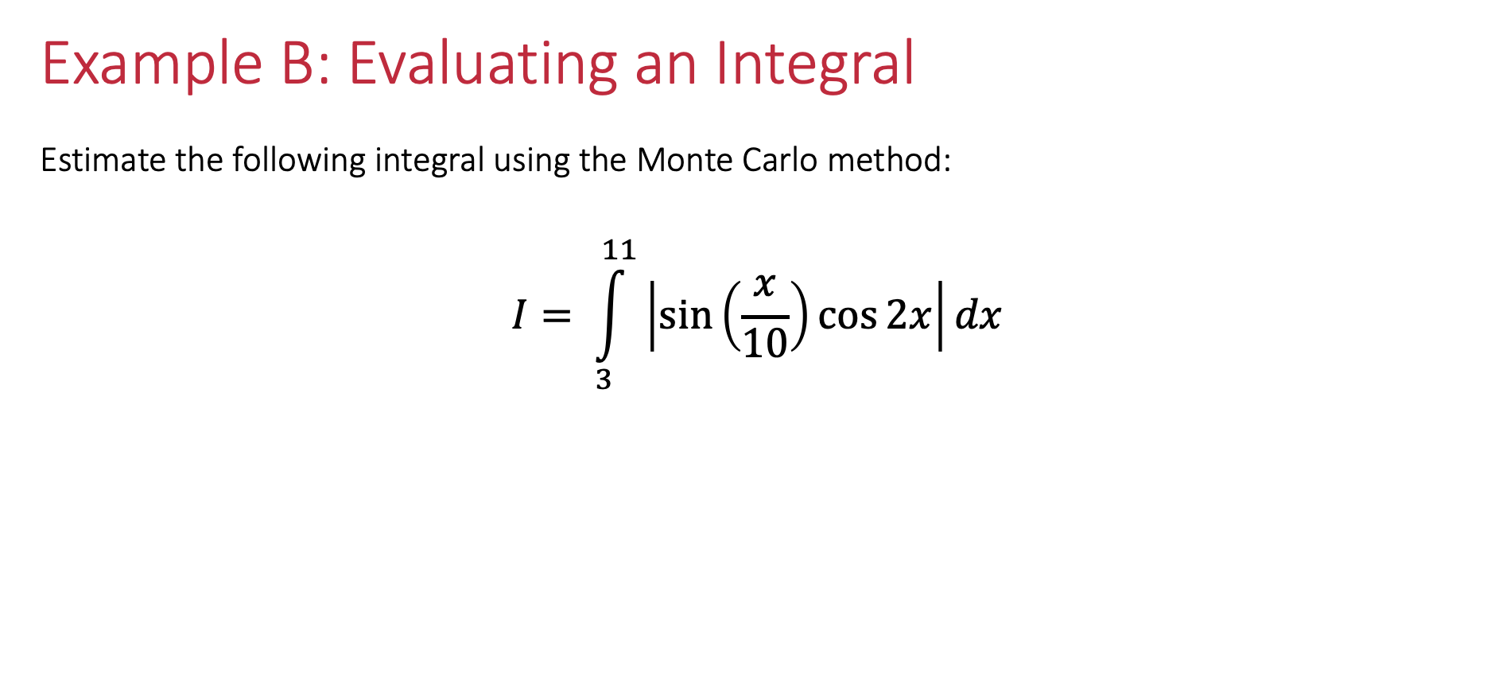
Example B: Evaluating an Integral
Estimate the following integral using the Monte Carlo method:
$$I= \int_{3}^{11}{\left|\sin\left(\frac{x}{10}\right)\cos{2x}\right|dx}$$

Slide 17
Example B: Evaluating an Integral

Slide 18
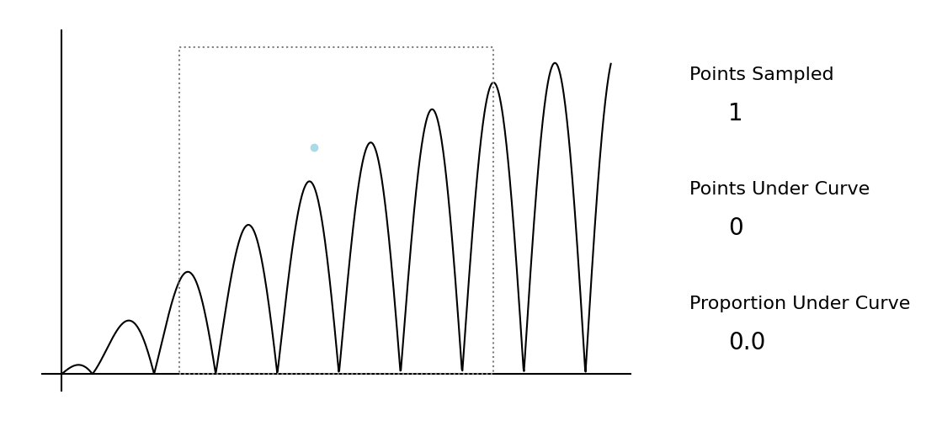
Example B: Evaluating an Integral

Slide 19
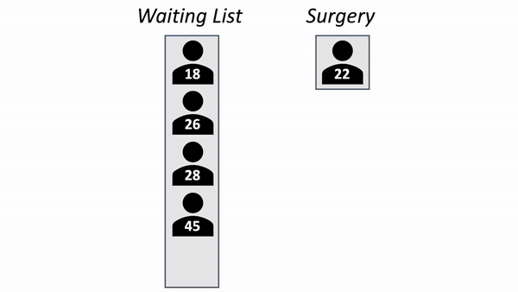
Discrete Event Simulation

Slide 20
Discrete Event Simulation
Customer | Inter-arrival time | Arrival date | Service start date | Waiting time | Service time | Exit date
1 | 1.46 | 1.46 | 1.46 | 0.00 | 2.87 | 4.33
2 | 4.02 | 5.48 | 5.48 | 0.00 | 0.07 | 5.55
3 | 5.66 | 11.04 | 11.04 | 0.00 | 0.38 | 11.42
4 | 0.17 | 11.21 | 11.42 | 0.21 | 1.82 | 13.24
5 | 1.03 | 12.23 | 13.24 | 1.01 | 5.57 | 18.81
6 | 9.49 | 21.72 | 21.72 | 0.00 | 9.58 | 31.30
7 | 5.91 | 27.63 | 31.30 | 3.67 | 1.94 | 33.24
8 | 1.44 | 29.07 | 33.24 | 4.17 | 6.52 | 39.76
9 | 6.13 | 25.20 | 39.76 | 14.56 | 1.74 | 41.50
10 | 8.38 | 33.58 | 41.50 | 7.92 | 2.07 | 43.57

Slide 21
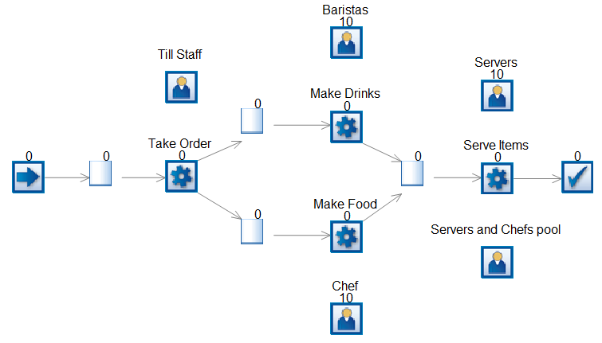

Discrete Event Simulation

Slide 22

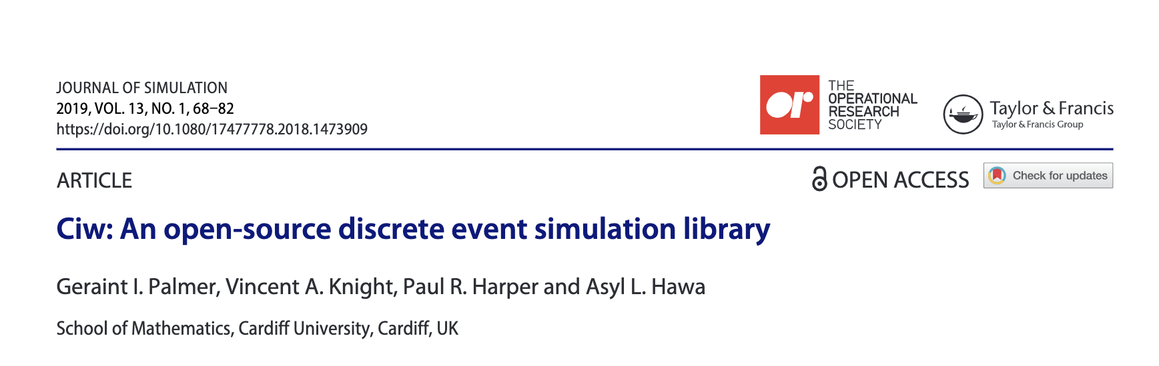
The Ciw Library
https://ciw.readthedocs.io/en/latest/

Slide 23
Example C: An M/M/1 Queue
There is a very popular arcade machine in the University staff room, so popular that staff will happily wait in a line to use the machine. When a member of staff wants to play on the machine, if there are no other staff present, they begin using the machine immediately. If there is another member of staff already playing on the machine, they will wait and form a queue to play. When someone finishes playing, the person at the head of the queue can then begin playing.
Staff who want to play on the machine arrive randomly at a rate of 11 per hour. The times between each consecutive arrival is Exponentially distributed. The amount of time staff spend on the machine is random, and is Exponentially distributed, lasting on average 5 minutes.
How long on average to staff spend waiting to play on the arcade machine?
What will be the effect of investing in a second machine?

Slide 24
Task 2: An M/G/c Queue
Assume you are a bank manager and would like to know how long customers wait in your bank. Customers arrive randomly, roughly 12 per hour with Exponentially distributed inter-arrival times. Service times are random, also Uniformly distributed, lasting between 5 and 17 minutes. The bank is open 24 hours a day, 7 days a week, and has three servers who are always on duty. If all servers are busy, newly arriving customers form a queue and wait for service.
On average how long do customers wait?
How many customers wait over 10 minutes?
How many customers wait over 1 minute?

Slide 25
Example D: A Network of Queues
At an Emergency Department patients arrive randomly, with Exponentially distributed inter-arrival times, at a rate of one every minute. They first queue up for reception to register to be seen. They then enter another waiting room to be seen by a clinician. In rare cases (5% of the time), a clinician will send the patient back to reception to re-register, as they would need further consultation with another clinician. It takes exactly 2.2 minutes to register at reception, and consultation lengths are Uniformly distributed between 5 and 28 minutes. There are 3 receptionists and 18 clinicians.
On average how long to patients wait for consultation?
How does this change if an extra clinician is hired?

Slide 26
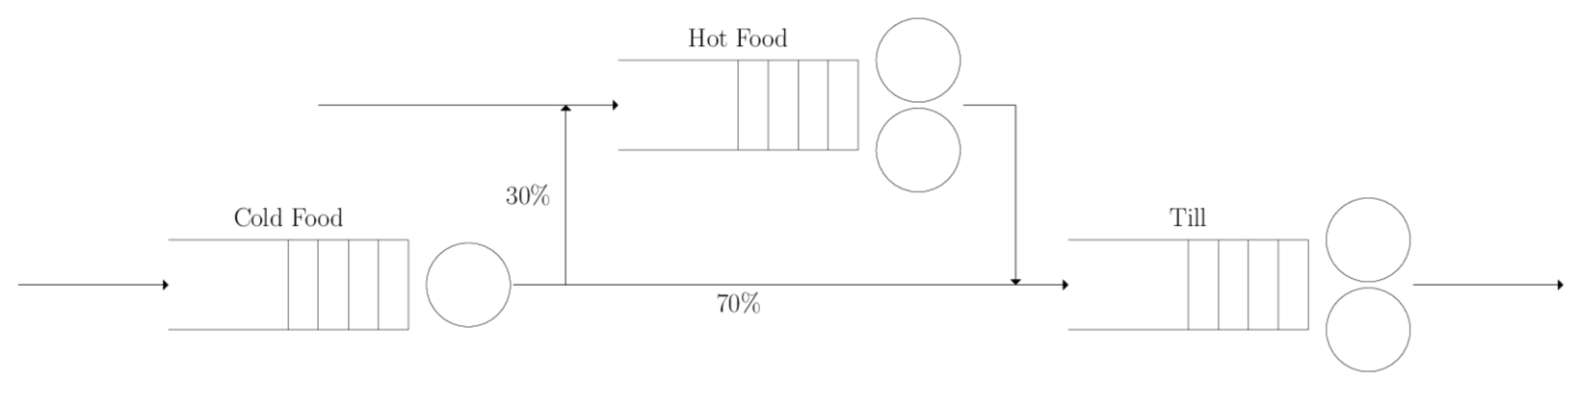
Task 3: A Café
How many customers are served during a typical lunch hour?
How long are customers expected to wait at each counter?
How long are customers expected to be in the system before leaving with their food?
You are provided with one extra member of staff. Where should that member of staff be stationed (the cold food counter, the hot food counter, or the till) to have the greatest effect on the customers’ overall waiting times?

Slide 27
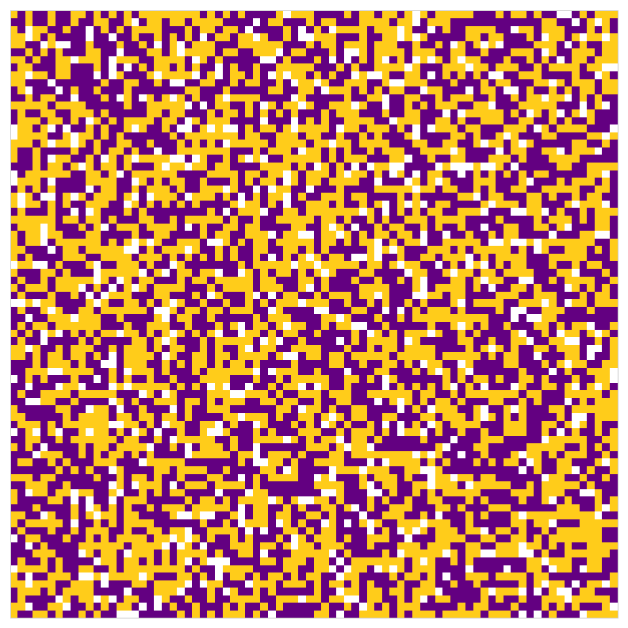
Other Paradigms: Agent-Based Simulations
Schelling’s Segregation Model
Content if more than ½ it’s neighbours are the same colour as itself.
Moves to a random empty spot it less than ½ its neighbours are the same colour as itself.

Slide 28
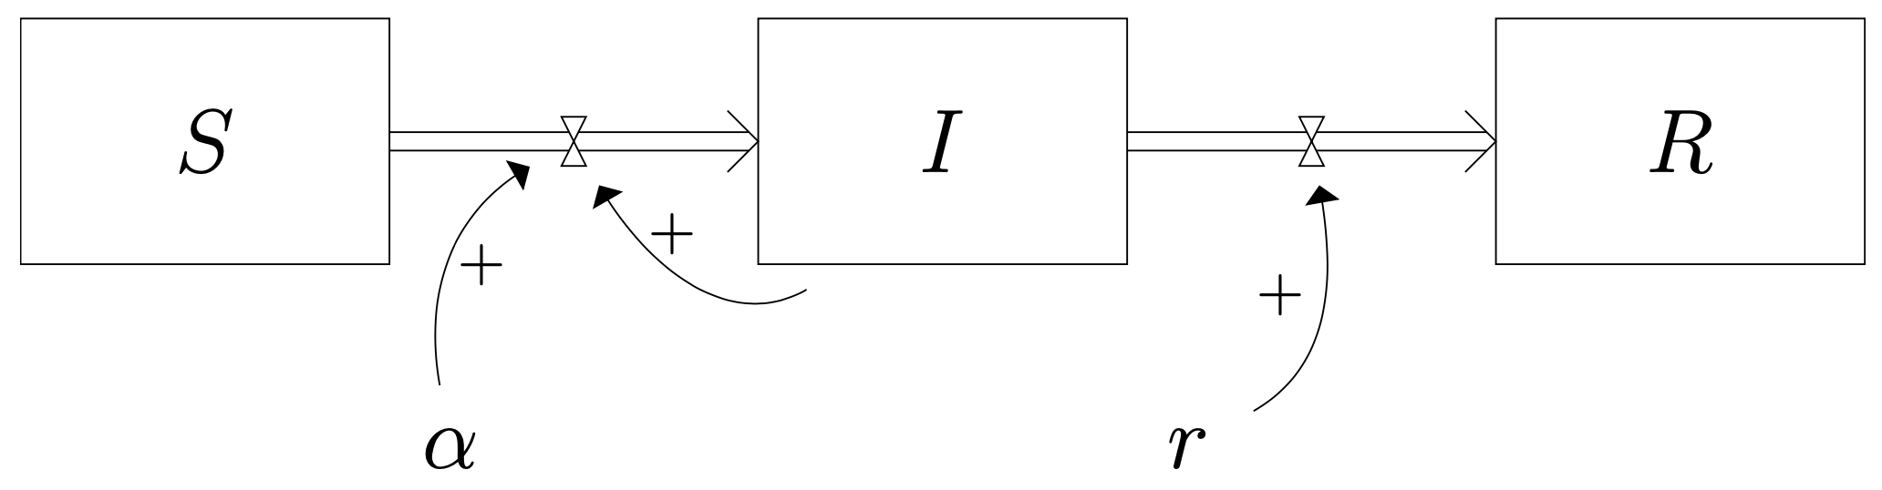
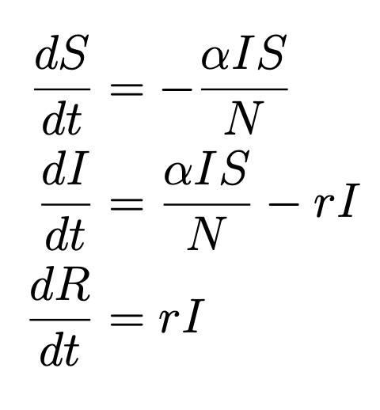
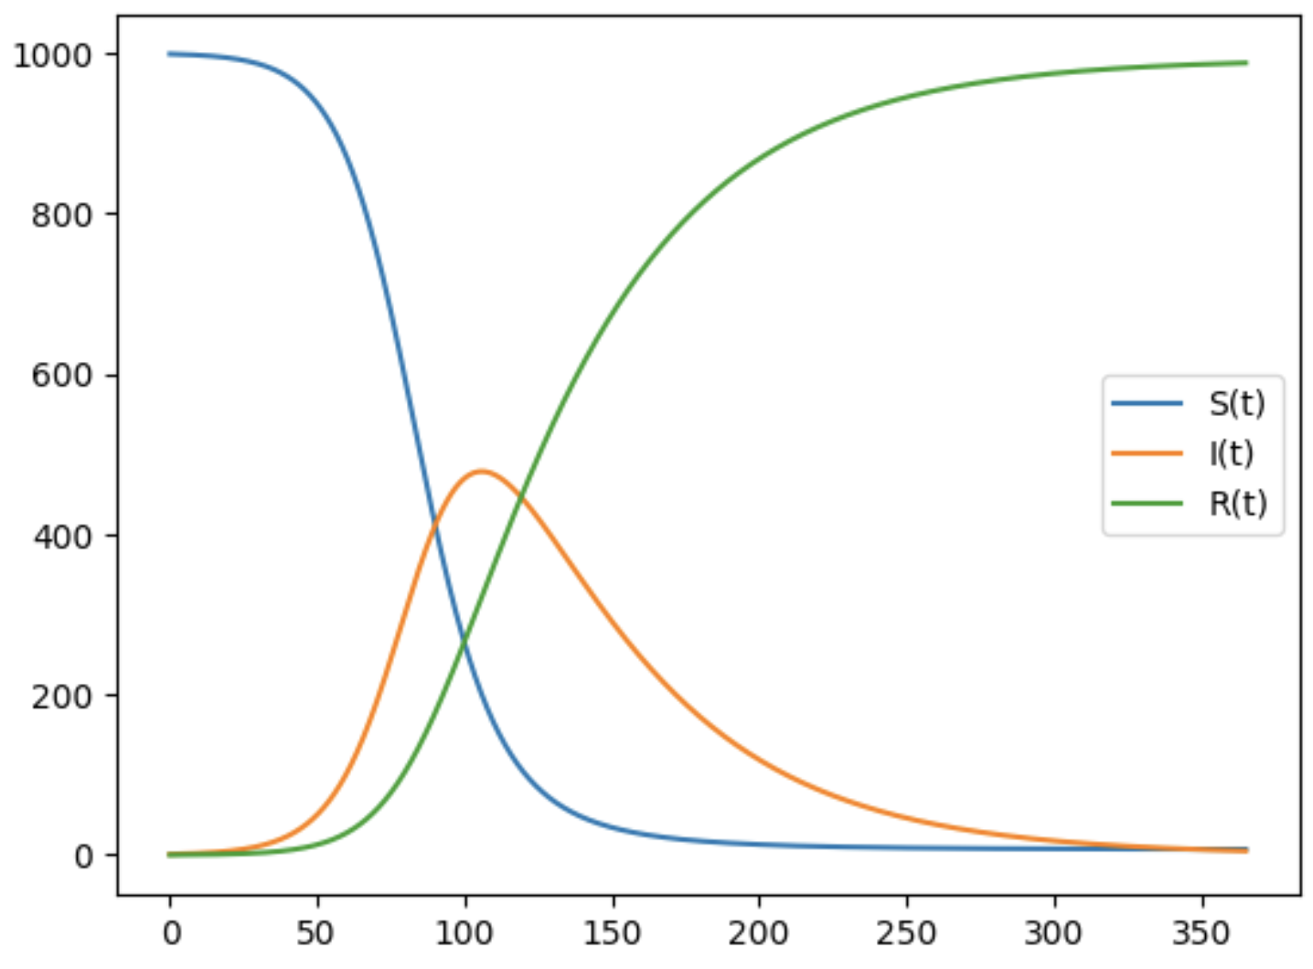
Other Paradigms: System Dynamics

Slide 29
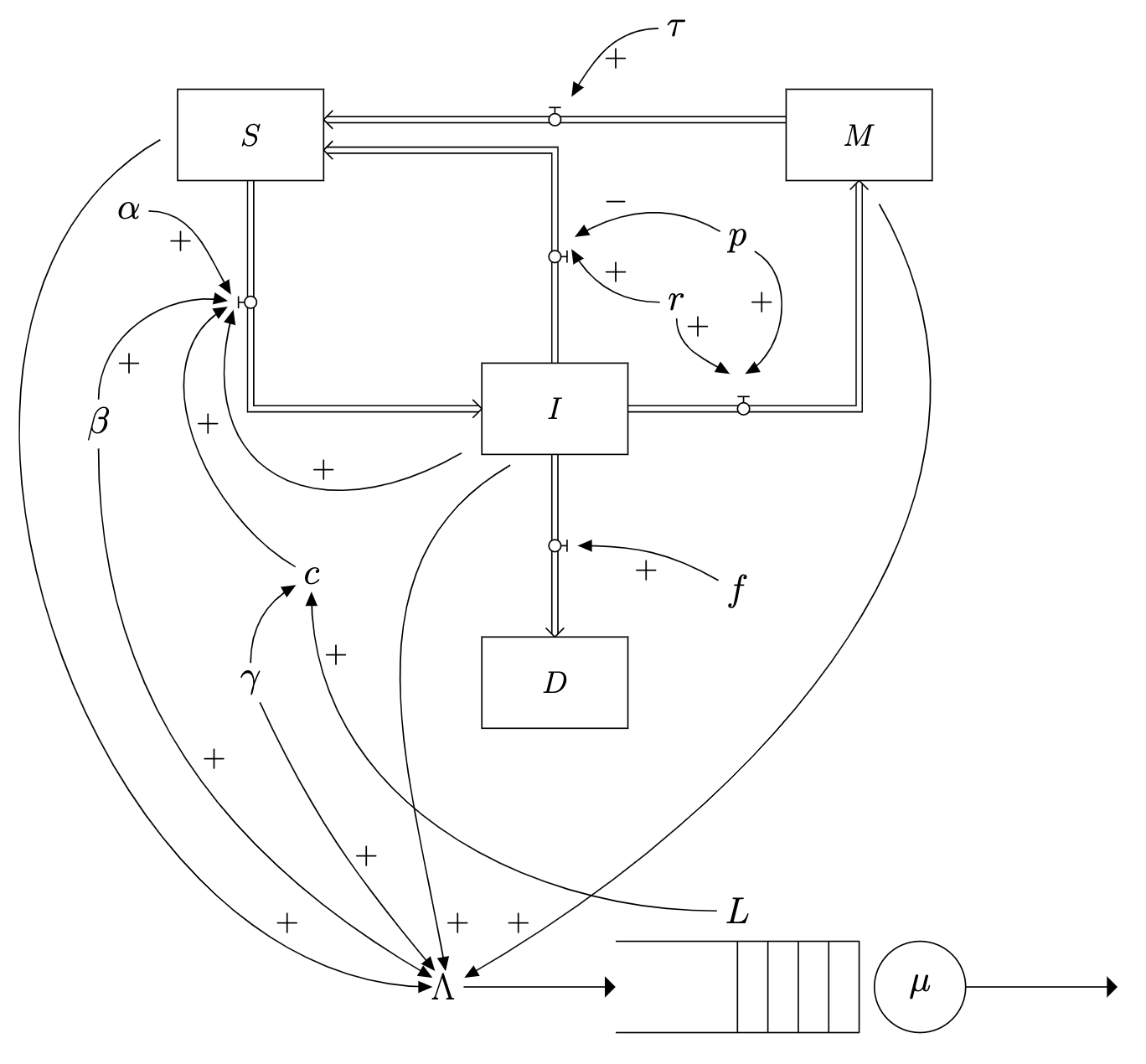
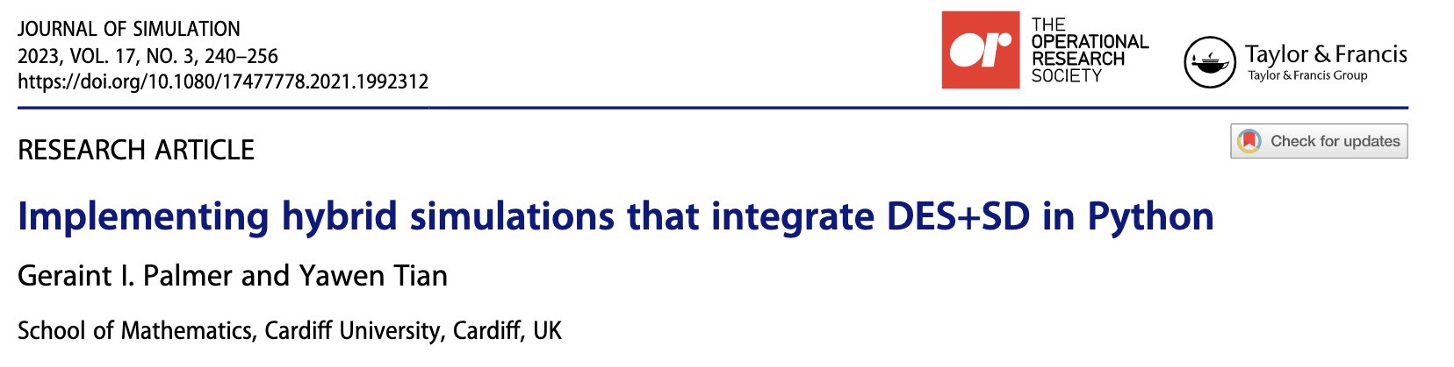
Other Paradigms: Hybrid Simulation

Slide 30
Simulation & Optimisation
Generate initial solution
Evaluate solution
Modify solution
Check if better than best
Record as best
Stopping criteria?
End

Slide 31
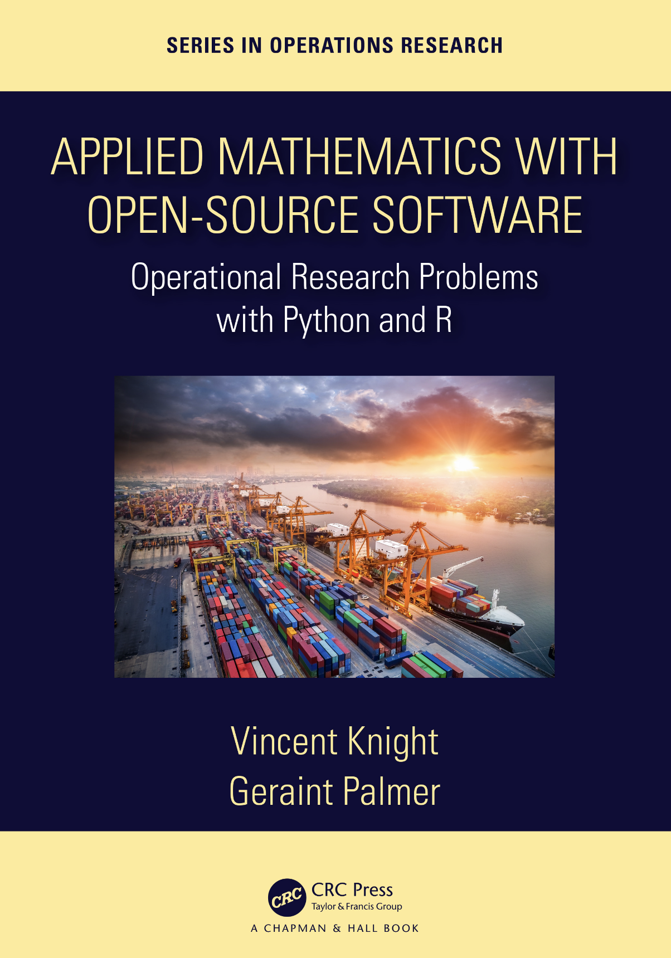
https://github.com/drvinceknight
/amwoss/blob/main/src/main.pdf

Slide 32
Simulation Modelling with Python
Dr Geraint Palmer
Cardiff University
Solutions: https://github.com/geraintpalmer/SimulationWorkshop

